Slide 1
Testing types Trello: web-based Project Management Application
Nazar Ivantsiv
January 2015

Slide 2

Agenda
Positive testing
Negative testing
Smoke testing
Functional testing
Non-functional testing:
Usability testing
Performance, Load and Stress testing
Localization
Internationalization

Slide 3
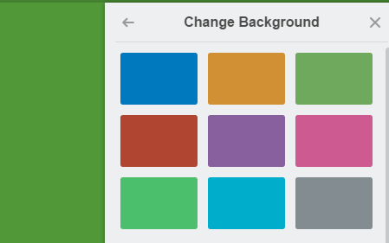
Positive testing
Task: Check if user can change background color.
Testing Procedure:
Press ‘Show menu’ button then ‘Change Background’.
Select available color.
Check if the background color changes to which was selected.
Defect: When selecting ‘Orange’ color, the background becomes green.

Slide 4
Negative testing
Task: As a user I want to type special characters in field Username.
Testing Procedure:
Under the ‘Save’ button we see rules for these text fields – ‘Usernames require a minimum of 3 characters, alphanumeric only.’
Entered 3 more special characters !@# after or in username.
Push ‘Save’ button
Defect: When pushing ‘Save’ button, username with special characters is saved.

Slide 5
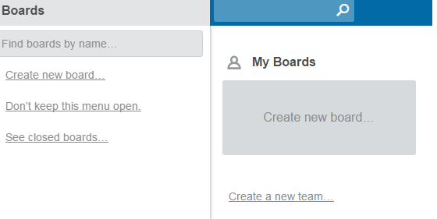
Smoke testing
Task: As a user I want to create new board.
Smoke Testing Procedure: quickly check the main Trello features (create new board, create new team).
Defect: There is no ability to Create new board. Button “Create new board” does nothing.

Slide 6
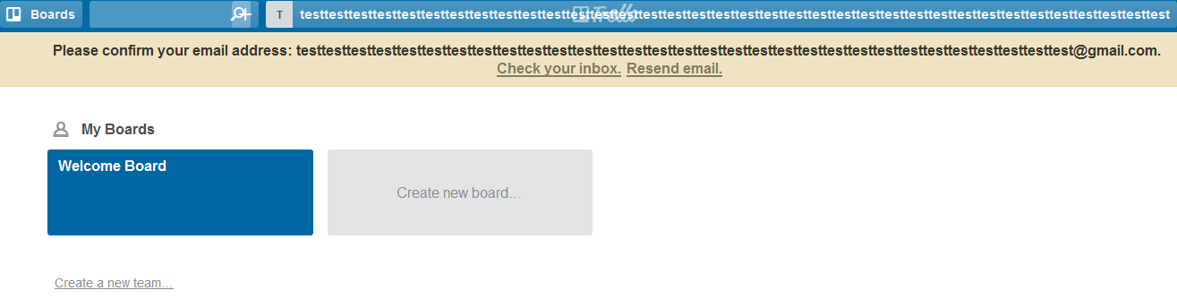
Functional testing
Task: As a User I want to enter 25 symbols in ‘Name’, ‘Email’ and ‘Password’ text fields.
Functional Testing Procedure:
Test ‘Name’, ‘Email’ and ‘Password’ fields by entering letters, numbers and special characters.
Then push ‘Create new account’ button.
Defect: More then 200 letters, numbers and special characters can be entered in all text fields. After signing up, application can be used without email verification.

Slide 7
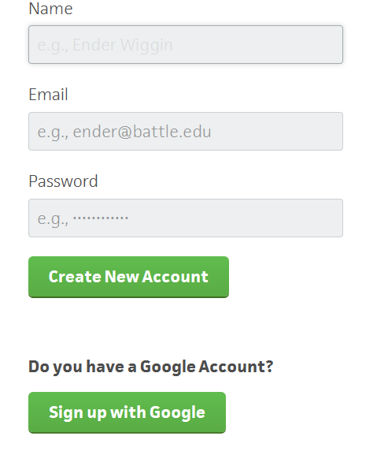
UI testing
Task: Check if all text fields are located as in mock-up.
Usability Testing Procedure:
Check ‘Name’ text field.
Check ‘Email’ text field.
Check ‘Password’ text field.
Defect: ‘Email’ text field is located after ‘Name’ text field.

Slide 8
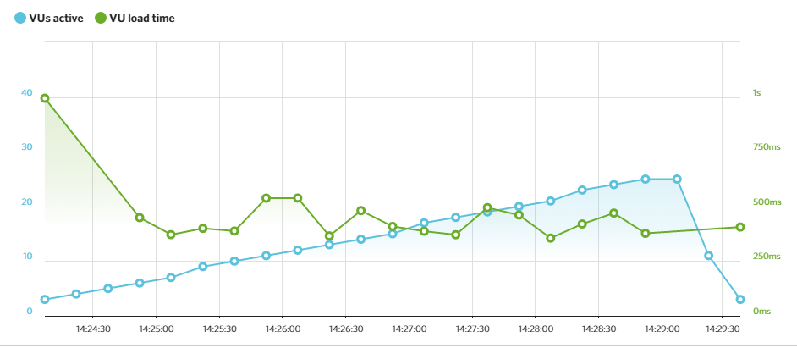
Performance and Load testing
Task: Server should respond in less than 1,5 sec when up to 100 users access it concurrently. Server should respond in less than 4 sec when up to 300 users access it concurrently.
Server should allow up to 500 concurrent connections.
Testing Procedure:
1. Emulate different amount of requests to server in range (0; 300), for instance, measure time for 10, 25, 50, 240 and 290 concurrent users.
2. Emulate different amount of requests to server close to pick value, for instance, measure time for 400, 450, 500 concurrent users.
Defect: starting from 200 Concurrent requests respond time is 7-10 seconds. Server returns “Request Time Out” starting from 490 concurrent requests.

Slide 9

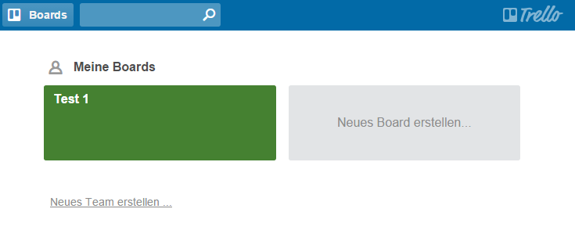
Localization testing
Task: Verify that ‘Change language…’ option translate application to German
Localization Testing Procedure:
Test all labels and captions on the page whether they are translated to German; force appearance of different messages (e.g.: when password or login does not exist) to check whether they are localized and not truncated
Defects:
Words ‘Board’ and ‘Team’ are not translated to German;
Notes:
Пес зникає при зміні мови )

Slide 10
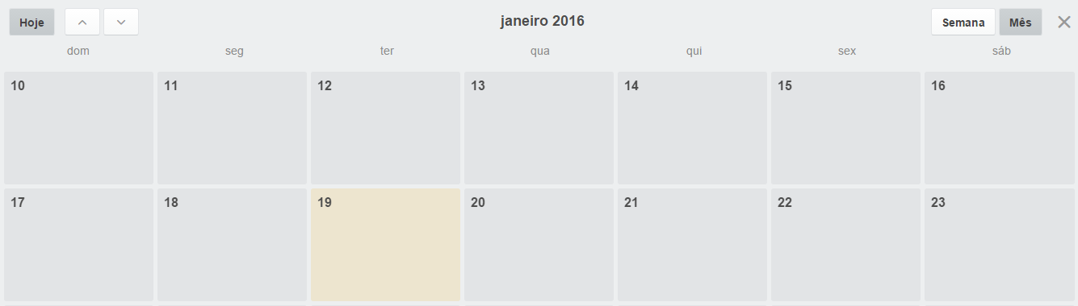
Internationalization testing
Task: Verify that ‘Change language…’ button doesn’t change the sequence of days in week in calendar.
Internationalization Testing Procedure:
Go to Trello Calendar.
Then switch to Portugal language.
Defects:
The sequence of days changes from Mon-Sun to Sun-Sat.

Slide 11
Thank you
Nazar Ivantsiv
IF MQC-62
Nazar.ivantsv@gmail.com
https://github.com/nivantsiv/

